Slide 1
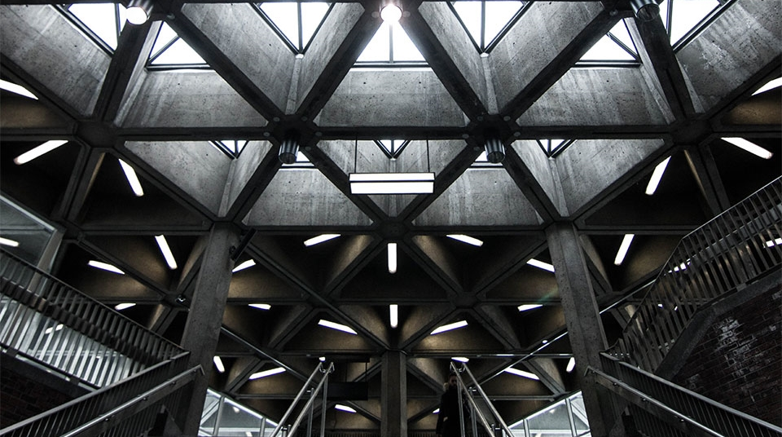
Common Sense Economics
2
+
2
+
Presented by Similoluwa Oluwole, Stephanie Sampson, Stephen Smith, Jason Stowers, and Katrina Watts

Slide 2


3 Main CONCEPTS
2
+
2
+
Personal Finances
Role of profit and Loss
Incentives Matter

Slide 3
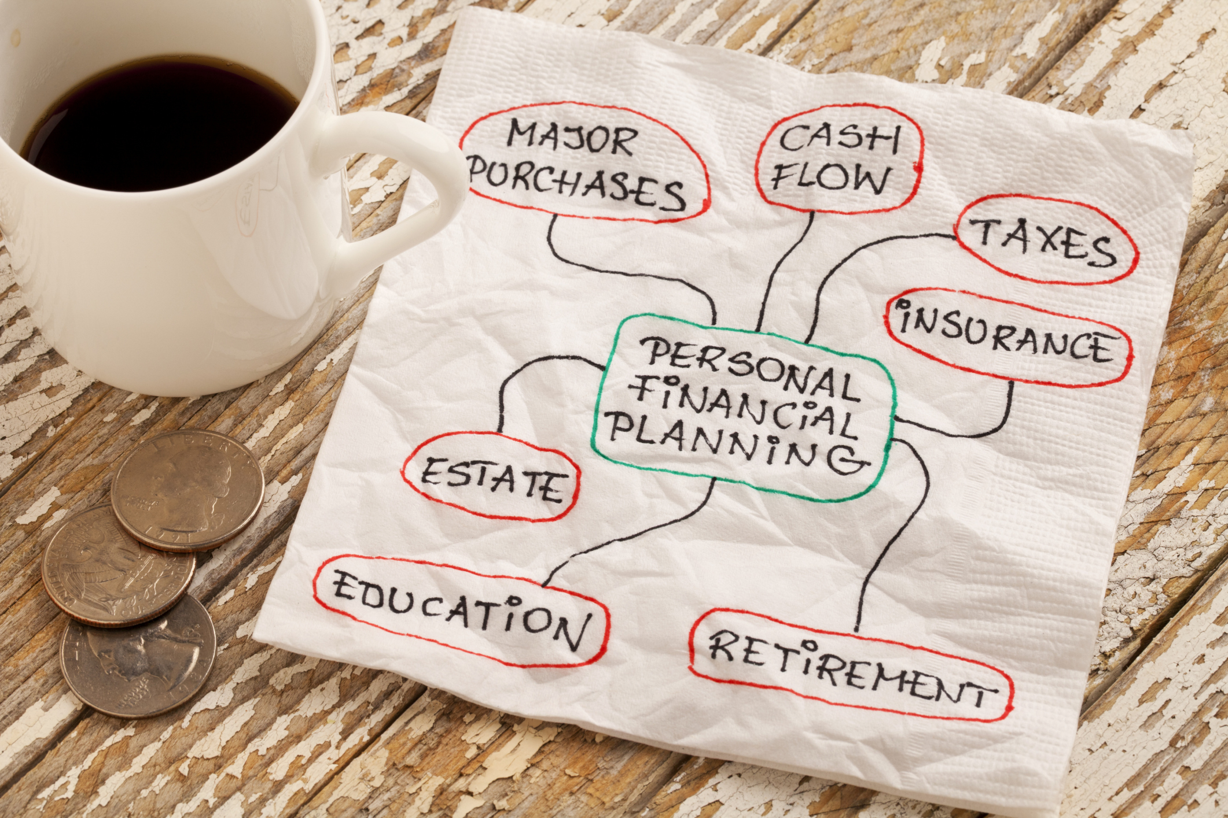
Personal Finances
Use budgeting to help you spend your money effectively and save regularly.
One way to get a better handle on spending is to create a budget
Budgeting your income and monitoring your behavior will help you evaluate your spending
Change spending habits
Be smart about large purchases

Slide 4
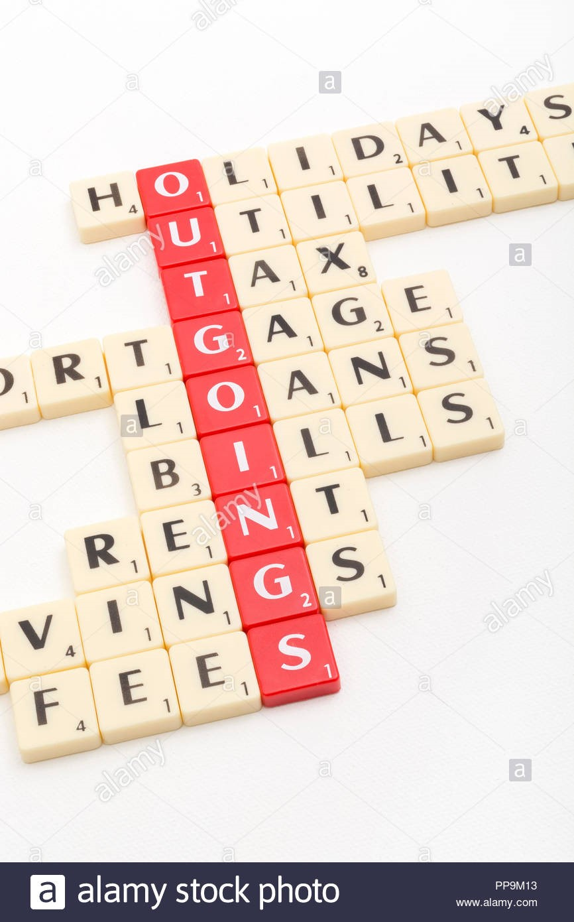
Personal Finances
Cont’d
Key Points for Financial Security
Key Elements for Wise Spending Habits
Documenting expenses produces wise spending choices.
Write down all expenses
Save for Big Purchases
Avoid using credit cards for purchases
Set Realistic Goals
  Short Term
  Long Term
Create a Budget
  Set a Budget
  Start a Savings
  Eliminate Credit Card waste
  Emergency Fund

Slide 5
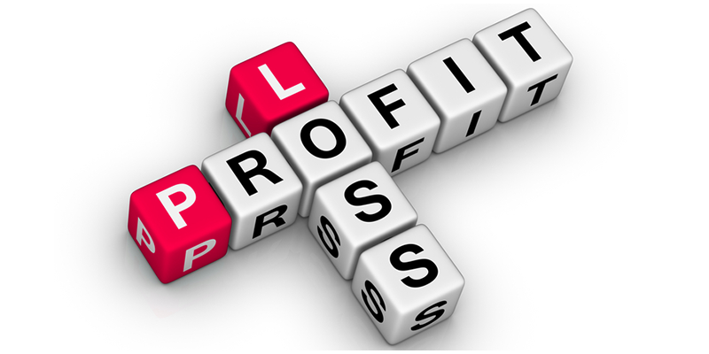
Role of Profit and loss
2
+
Profit = Total Revenue – Total Cost
The risk-reward structure of operating a business is evident. Entrepreneurs who operates business efficiently will prosper, while the ones who does not fail. Profit and loss are the primary drivers of this risk-reward system.
What is Profit?
Profit is the surplus in revenue after a business has accounted for all costs. In other words, it is total revenue minus total cost.

Slide 6

Role of Profit
Benefits to business owners and stakeholder
Reward for business efficiency
Capital for investment in research and development
Incentive to take risk
High profit should attract new firms into the industry
Insurance for unexpected business risk(s)

Slide 7
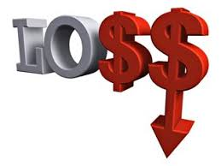
Role of Loss
Loss occurs when revenue is less than costs
Widely accepted as negative in any circumstance
A result of:
  Inefficient investing
  Unplanned risk event
Notes:
Loss
It is an undesirable outcome in business operation. Organization who invest inefficiently or besieged by unplanned risk event will be penalized with loss and financial difficulties. Loss occur “when the total revenue from sales is less than the opportunity cost of the resources used to produce a good or service” (Gwartney, 2016, p.27)
Role of loss
Loss is seen overwhelmingly as negative in any circumstances. However, one of its potential benefit is the ability to direct business away “from wasteful activities that reduce resource value” (Gwartney, 2016, p.26). Businesses do not have to experience loss in order to curtail wasteful activities, the thought of it serves as a constant reminder of the consequence of mismanagement.

Slide 8

Incentives Matter
2
+
The expected pay off from actions
Influences human behavior in some way
Influence political choices
Economics basic postulate
Self-centered vs. altruistic
Monetary and nonmonetary factors
Market and Politicians face different incentives
Notes:
It’s an important part of human nature to make decisions based on incentives. People ultimately make decisions based on what they believe will benefit them most. The basic postulate in economics is about hoe people choose, what motivates their actions, and how actions influence their personal welfare and that of others.
As an option becomes more costly, less is chosen. When an option becomes more attractive, more will choose it. Payoff and value derived from choices on the part o the consumer, changes in pricing (monetary value incentive determined by supply and demand) works coordinating the actions of buyers and sellers, just as changes in policy are driven by the choice of voters in selection of political candidates, as candidates select proposals that will help to drum up support for election to public office.
People act for a variety of reasons. Some out of self-interest, some for the good of society, however both self-centered and altruistic motivation will be influenced by changes in personal cost and benefits. Ultimately, changes in incentives influence everyone’s choices.

Slide 9

Incentives (Cont’d)
Private Ownership
Government Owned Property
Provides strong incentive for maintenance and care
Will not allow property to be damaged or abused
Bear consequences of the property decline
Receive benefits when property appreciates
Good stewardship is awarded
Encourages using property for profit
Incentive for good care is weakened
Government housing is often run down
Poorly maintained property
True for capitalist and socialistic countries

Slide 10
THANK YOU
2
+
2
+
From Similoluwa Oluwole, Stephanie Sampson, Stephen Smith, Jason Stowers, and Katrina Watts
Reference
Gwartney, J. D. (2016). Common sense economics: What everyone should know about wealth and prosperity. New York: St. Martin’s Press.

